Slide 1
15 Ways to Improve Implementation Initiatives
Notes by Ben Boerkoel, Kent ISD, based on a
training by Beth Steenwyk – 10.11.11

Slide 2
Shared Vision and Purpose
How will we create the organizational vision and purpose to ensure that it is shared by all stakeholders?
How will we ensure a structured and collaborative process to identify and articulate the needs that, when addressed, will allow us to reach our vision and achieve our purpose?

Slide 3
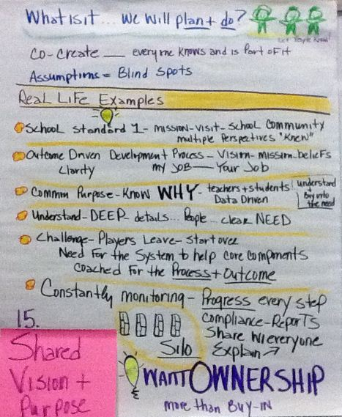
Shared Vision and Purpose

Slide 4
Communication
How will we communicate the need so all stakeholders clearly understand and own it?
How will we communicate the plan/solution so that everyone understands their role in implementing the solution?
How will be ensure a consistent message?
What context will amplify the message?
What timing would amplify the message?

Slide 5
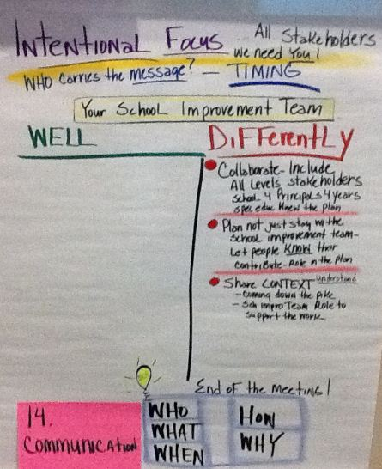
Communication

Slide 6
Selection Process
What is the process to identify and articulate the need?
Who will participate in the selection process?
What data will be used to determine the need?
How will we insure that the “right” people own the need?
If there is turnover, how will we re-establish the need with new implementers?
What process will we use to select the solution/project/strategy?
Who will participate in the selection process?
What research will be used to identify the solution?

Slide 7
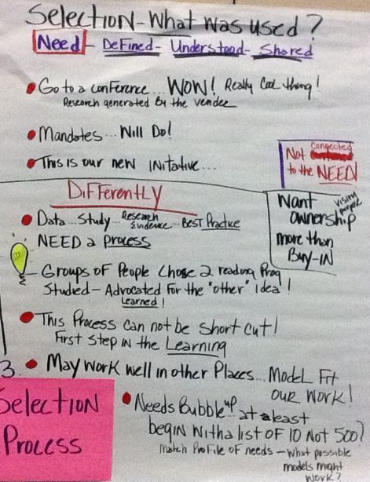
Selection Process

Slide 8
Readiness
How do we help people get ready to adopt the process?
How will we build consensus?
How will we build shared purpose?
How will be build ownership?
How do we help people get ready to implement the process?
How will we ensure that those implementing the process have the competencies needed to implement with fidelity?
How will we ensure that leadership understands the process to the extent necessary to support it?
How will we ensure that all systems are in place to support implementation?

Slide 9
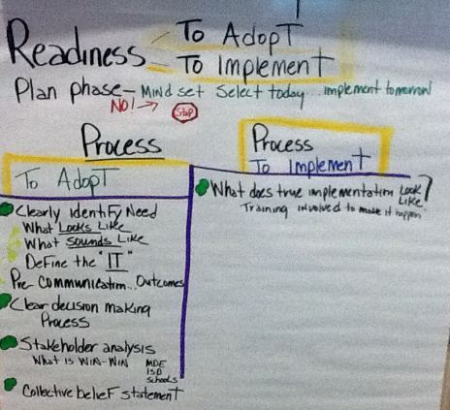
Readiness

Slide 10
Identify Critical Features
How will we ensure that stakeholders understand the critical features /non-negotiables (the “looks like, sounds like”) of implementation?
How will we ensure that stakeholders are prepared to implement the non-negotiables?

Slide 11
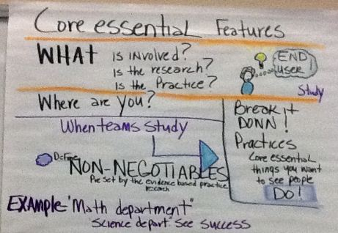
Identify Critical Features

Slide 12
Complexity of Implementation
How can we make implementation and outcomes understandable for all stakeholders, including their role in implementation?

Slide 13
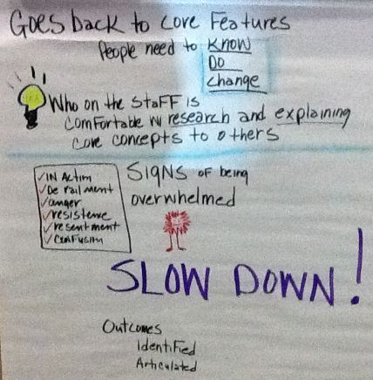
Complexity of Innovation

Slide 14
Demonstrations and Scaling
How will we first implement the strategy on a manageable level?
How will we scale the strategy to a larger audience?
How will the initiative change due to expansion?
How will you support a scaled version of the initiative?
What roles and functions need to change to scale the initiative?

Slide 15
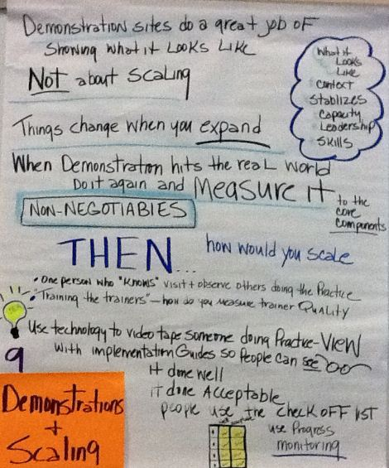
Demonstrations and Scaling

Slide 16
Leveraging
How will we prepare for and manage/leverage the reactions to the change needed to implement the strategy?
How will we understand the impact the change will have?
What will we do to address the elements of change so that implementation will be successful?
How will we respond when we don’t get the results we wanted? How will we analyze and identify the factors that may have contributed to the results?

Slide 17
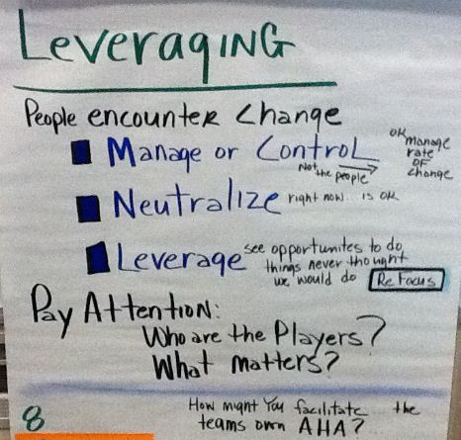
Leveraging

Slide 18
Capacity Building
How will we build capacity to implement the strategy?
How will we ensure sufficient planned professional learning for all stakeholders involved in implementation?
How will we ensure that the professional learning is aligned with the professional learning standards? Has clear goals and outcomes? Aligns with the needs of the initiative?
How will we implement a coaching process that is aligned with training outcomes and initiative standards? How will we provide opportunities for stakeholders to improve their performance?
How will we embed “looks and sounds like” performance standards related to implementation fidelity within the staff evaluation system?

Slide 19
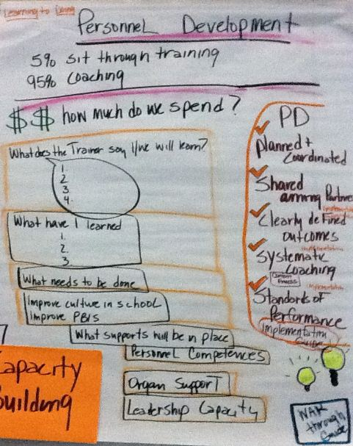
Capacity Building

Slide 20
Role and Function Change
How will we ensure that systems are in place to support the necessary changes in roles and functions?
How will we understand the initiative sufficiently to anticipate the necessary role and function changes within the system?
How will we align staff and their skills with the competencies needed for accuracy and fluency of implementation?
How will we identify and align/develop/change systems to support the accuracy and fluency of the initiative?
How will we build leadership that is committed to actively supporting the initiative?

Slide 21
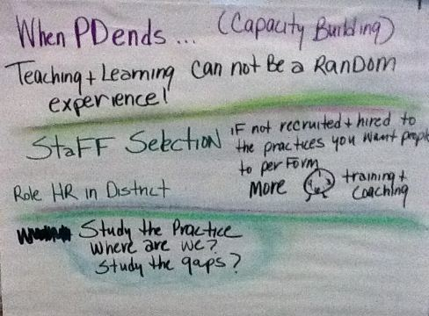
Role and Functional Change

Slide 22
Measurement and Progress
How will we measure adult implementation and student impact?
What are the clearly-defined indicators of success? At what level are these indicators in place?
What systems are in place to assure data-driven improvement? What systems are in place to collect and analyze data needed to ensure implementation fidelity?
How are we ensuring staff competency in effectively using data to problem solve?

Slide 23
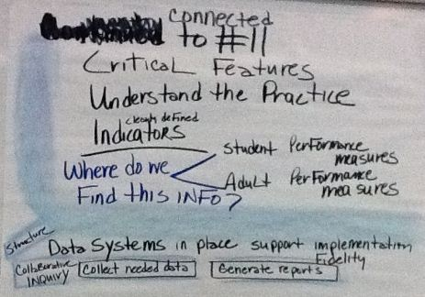
Measurement and Progress

Slide 24
Feedback and Support
What feedback and support loops are in place to address the following:
Status/stage of initiative implementation?
Competencies needed for implementation fidelity?
Leadership support necessary for initiative sustainability?
Systems necessary to support initiative implementation?
Continuous improvement cycles to eliminate barriers and optimize systems to improve implementation

Slide 25
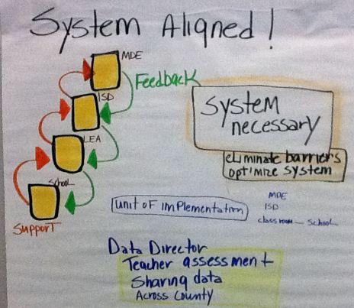
Feedback and Support

Slide 26
Aligned and Integrated
What are the district and building needs and priorities?
How will we ensure that district and building initiatives are aligned with needs and priorities?
How will we ensure that the work of district and building leadership aligns with needs and priorities?
How will we build capacity and alignment across needs and priorities? How might initiatives address multiple needs and priorities?

Slide 27
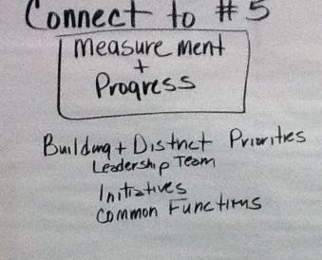
Aligned and Integrated

Slide 28
Braiding Initiatives
How will we build capacity and increase alignment between initiatives?
How will we reduce competition between initiatives?
How could common functions be leveraged to support the implementation fidelity of multiple initiatives?
How will we ensure that innitiatives across grade levels support student capacity to ensure coherence of curriculum, instruction, and assessment?
How can we ensure that school improvement efforts support the integration of initiatives?

Slide 29
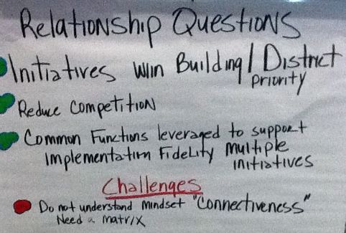
Braiding Initiatives

Slide 30
Leadership
How will we develop, support, and activate the leadership characteristics necessary to support implementation in an environment of change?
Technical leadership - Does the leadership have the skills to support and evaluate technical implementation of the chosen strategy/activity?
Adaptive leadership – Does the leadership have skills such as conflict management, collaboration, and servant leadership to evaluate and address issues beyond technical implementation? (E.g. cultural issues) and to devise solutions beyond technical solutions?
How will we develop distributed and shared leadership?

Slide 31
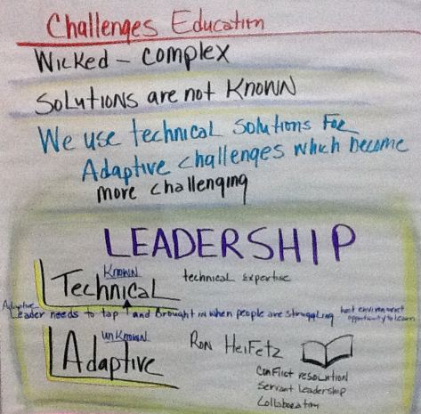
Leadership

